Slide 1


Training test Information Technology
http://schoolacademy.telerik.com
Preparation test for the IT National Olympics (NOIT)
Team "Grapefruit"
Telerik Academy

Slide 2


Computer Systems
Hardware Questions

Slide 3
Computer Systems(hardware)
The questions of this syllabus section are covering the following areas:
Computer Systems
Main components of computer systems, features, specifications, interaction
Basic principles of operation
Basic input-output interfaces and standards

Slide 4
Question
W
B
y
j
B

Slide 5
Answer
sdf
sdf
sdf
Information:
dfg
dfg

Slide 6



Software Systems
Computer Software

Slide 7
Computer programs (software)
The questions of this syllabus section are covering the following areas:
Computer Programs(software)
Essence, functions, classification
Creation
How to use (installation, startup, uninstall)

Slide 8
Question
f
j
AI
h
N

Slide 9
Answer
h
h
g
f
Information:
hg

Slide 10



Rules for working with and supporting computer systems
Installing, using, supporting, …

Slide 11
Working with computer programs
The questions of this syllabus section are covering the following areas:
Rules for working with computer systems and programs
Starting and stopping
Diagnostics
Finding problems
Support
Testing

Slide 12
Question
w
k
k
k
k

Slide 13
Answer
Ik
k
Information:
k

Slide 14

Data transfer and numbering systems
Channels for data transfer, units of measure, work with numbering systems

Slide 15
Data transfer and numbering systems
The questions of this syllabus section are covering the following areas:
IT tools for data transfer (different approaches and methods, physical environments and channels of transmission, advantages and disadvantages)
Basic units measuring information
Fundamentals of binary calculations
Calculations in different number systems

Slide 16
Question
Which one of the OSI model layers, does the protocol XDR belongs to?
Session layer
Transport layer
DataLink layer
Physical layer
Presentation layer

Slide 17
Answer
The presentation layer provides independence from data representation (e.g., encryption) by translating between application and network formats. The presentation layer transforms data into the form that the application accepts. The XDR, NFS and other protocols are closely related to this layer.
Information:
http://en.wikipedia.org/wiki/OSI_model

Slide 18





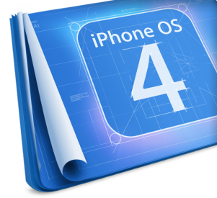









Operating Systems
Architecture, processes, users,
user interface, file systems

Slide 19
Operating systems
The questions of this syllabus section are covering the following areas:
Operating Systems - concepts, basic functions and tasks, types User interface - concepts, types. GUI - concepts, basic objects, key operations, organization, settings. File - concepts, characteristics. File system - concepts, types, logical and physical organization, basic objects and actions with them. Users, processes, multitasking.

Slide 20
Question
k
l
k
k
k

Slide 21
Answer
k
k
Information:
k

Slide 22

Software Engineering
Analysis, specification, design, prototype, implementation, testing, maintenance, ...

Slide 23
Software engineering
The questions of this syllabus section are covering the following areas:
Main phases of implementing a project - analysis, modeling, design, creation of a prototype, implementation, verification (testing and quality assurance), improvement and refinement, documentation, support. Modeling techniques. UML. Assessment of the validity of the project implementation. Planning and project management.

Slide 24
Question
k
k
k
k
k
k
k

Slide 25
Answer
k
Information:
k

Slide 26




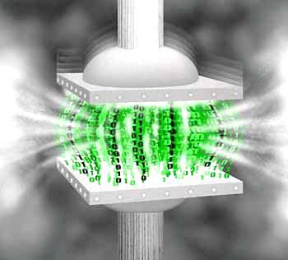




Data Compression
Compression algorithms, backup software

Slide 27
Data Compression
The questions of this syllabus section are covering the following areas:
Compression and decompression of data. Encoding with and without loss. Encoding with linear prediction. Algorithms of Shannon-Fano and Huffman. Arithmetic encoding. Dictionary encoding: LZ-77 and LZW. JPEG encoding. Backup programs - working with WinZIP and WinRAR. Creating and working principle of self-extracting and installation archives.

Slide 28
Question
k
k
k
k
k
k

Slide 29
Answer
k
k
k
Information:
k

Slide 30



Word Processing
Working with word processing software, file formats, encoding, text, tables, figures, ...

Slide 31
Word Processing
The questions of this syllabus section are covering the following areas:
Computer processing of texts
File formats (TXT, DOC, DOCX, RTF), converting
Ways for encoding text information (tables and encoding standards Unicode, Windows-1251, ASCII))
Problems in ensuring multilanguage

Slide 32
Word Processing (2)
Main components of text layout (paragraphs: alignment, spacing between lines and paragraphs, text: fonts, letter spacing, color, font size, effects). Standards for the design of texts. Working with styles. Inserting symbols and images. Inserting tables. Shaping tables, rows / columns, cells. Insert a text box. Figure Drawing. Shaping (formatting) per page: frame, background. Inserting new page section numbering content.

Slide 33
Question
k
k
k
k
k
k

Slide 34
Answer
k
k
Information:
k

Slide 35
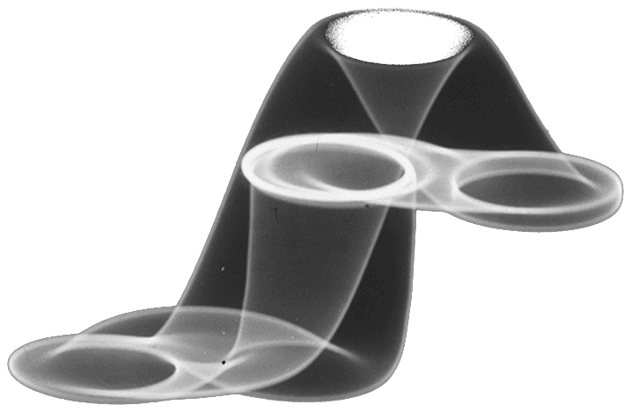



Computer Graphics
Raster and vector graphics, graphic file formats, image editors, color ranges

Slide 36
Computer Graphics
The questions of this syllabus section are covering the following areas:
Computer graphics. Graphics file formats (JPG, GIF, PNG, TIFF, EPS, PSD, AI, CDR). Compression of images. Vectors and graphic images. Conversion of image formats. Applications (creating graphics, analysis and image recognition, computer art). Graphic image editors. Filters and effects. Colors: RGB, CMYK, Panton, 16-bit color.

Slide 37
Question
Which one of the following IS NOT an algorithm for encoding of bi-level image data, defined by the “CCITT” organization?
G31D
G32D
G41D
G42D

Slide 38
Answer
The CCITT actually defines three algorithms for the encoding of bi-level image data:
Group 3 One-Dimensional (G31D)
Group 3 Two-Dimensional (G32D)
Group 4 Two-Dimensional (G42D)
Information:
http://www.fileformat.info/mirror/egff/ch09_05.htm

Slide 39






Databases
Data models, tables, relations , SQL

Slide 40
Databases
The questions of this syllabus section are covering the following areas:
Databases. Control systems for databases. Logical and physical organization. Data models
Relational databases. Tables and relations. Objects in databases. Data types
Language SQL. Types of SQL commands and queries

Slide 41
Question
k
K
K
K
k

Slide 42
Answer
k
k
Information:
k

Slide 43

Information Systems
ERP, CRM, BI, BPM, FMIS, CAD/CAM, CMS, software architectures

Slide 44
Information Systems
The questions of this syllabus section are covering the following areas:
Information systems. Classification (management organization - ERP, production management, relations with customers and suppliers - CRM, Reporting, Analysis and Forecasting - BI, to solve specific problems, ...). Lifecycle (milestones in the creation and use). Main functions and tasks. System architecture - double layer (client / server), three-layer, N-layer (distributed), cloud computing.

Slide 45
Question
k
K
K
K
k

Slide 46
Answer
K
k
Information:
K
k

Slide 47


Security and data protection
Symmetrical and asymmetrical encoding algorithms, cryptographic hash, digital signature, digital certificates

Slide 48
Security and data protection
The questions of this syllabus section are covering the following areas:
Security and data protection. Methods and algorithms for encryption: symmetric encryption algorithms - DES, 3DES; asymmetric cryptographic algorithms (with public and private key) - RSA, DSA. Cryptographic hash algorithms - SHA-1, MD5. Electronic signature. Public Key Infrastructure (PKI). Digital certificates.

Slide 49
Question
Which of the statements below is FALSE?
When DSA is used, not the whole messages is encrypted - only its hash;
ElGamal encryption system is an asymmetric key encryption algorithm for public-key cryptography;
RSA algorithm is not integrated in Microsoft operation systems;
Camellia is symmetric cryptography algorithm.

Slide 50
Answer
RSA is algorithm for data encryption, in which are used different keys for encryption and decryption. The length of the key, used for encryption is between 512 and 1024 bits. RSA algorithm is the most widely used algorithm for encryption and it is integrated in a lot of operation systems, including Microsoft, Apple, Sun and Novell operation systems.
Information:
http://en.wikipedia.org/wiki/RSA_(algorithm)

Slide 51




Presentation Systems
Presentation software, preparation of presentations, slides, effects, notes, colors, images, sound, video

Slide 52
Presentation Systems
The questions of this syllabus section are covering the following areas:
Presentation of information by means of information technology. Computer presentation - slide effects, notes, color scheme templates
Designing presentation materials - use of color, text, images, sound, animation and video
Presentation software (presentation systems)

Slide 53
Question
k
K
K
K
K

Slide 54
Answer
k
K
k
Information:
k

Slide 55
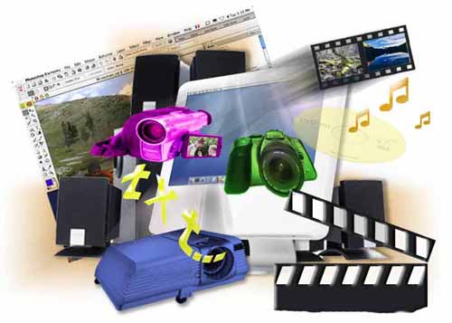



Multimedia
Software for creation / processing multimedia: audio, video, file formats

Slide 56
Multimedia
The questions of this syllabus section are covering the following areas:
Multimedia. Technologies for creating multimedia applications. Software tools for creating multimedia products. Generating animation and films (insertion and processing of images, sound, text). Compression of multimedia files. Converting multimedia file formats. Software for playing multimedia products, animation and movies.

Slide 57
Question
k
K
K
K
K
k

Slide 58
Answer
k
k
Information:
k

Slide 59


Computer Networks
OSI model, network models, protocols, standards, hardware

Slide 60
Computer Networks
The questions of this syllabus section are covering the following areas:
Computer networks. Architecture of the OSI model. Network Protocols
LANs - concepts, types according to organization management, topology, basic standards, hardware
Global computer networks - concepts, connections, addresses, basic services. Users and access to resources

Slide 61
Question
k
K
K
K
K

Slide 62
Answer
k
k
Information:
k

Slide 63




Structure of the Internet
Internet, protocols, services, WWW, HTTP, FTP, SMTP, POP3, IMAP, WebDAV, IP, DNS, …

Slide 64
Structure of the Internet
The questions of this syllabus section are covering the following areas:
Internet - nature, technical and technological aspects. Client-server architecture
Basic services and protocols– HTTP, FTP, POP3, SMTP
Types of Internet Access– dial-up, ISDN, LAN, DSL/ADSL, Wi-Fi
Internet address– IP addresses, DNS services, top-level domains. Hosting.

Slide 65
Question
Which of the following is NOT true about IPv6 ?
Length of an IPv6 address is 128bits;
IPv6 is the latest version of the Internet Protocol;
An IPv6 packet has two parts - a header and a payload;
IPv6 is represented in 8 groups, each group is written as 4 hexadecimal digits and the groups are separated by dashes.

Slide 66
Answer
Every device on the Internet must be assigned an IP address in order to communicate with other devices. With the ever-increasing number of new devices being connected to the Internet, the need arose for more addresses than IPv4 is able to accommodate. IPv6 uses a 128-bit address, allowing 2¹²⁸, or approximately 3.4×10³⁸ addresses.IPv6 addresses are represented as eight groups of four hexadecimal digits separated by colons, for example 2001:0db8:85a3:0042:1000:8a2e:0370:7334.
Information:
http://en.wikipedia.org/wiki/IPv6

Slide 67





Electronic Communication
E-mail, Skype, ICQ, IRC, MSN Messenger, Yahoo Messenger, Social Networks, forums, …

Slide 68
Electronic Communication
The questions of this syllabus section are covering the following areas:
Electronic Communication
Network mail– e-mail clients and web-based interfaces and protocols
Calls in real time– IRC, ICQ, Skype, MSN Messenger, Yahoo Messenger – operating principles and protocols
Social Networks

Slide 69
Question
k
K
K
K
K

Slide 70
Answer
jkj
k
Information:
Hfg
xgfg

Slide 71




World Wide Web (WWW)
How it works WWW? Protocol HTTP, GET, POST, URL, web browser, web page, website, …

Slide 72
World Wide Web (WWW)
The questions of this syllabus section are covering the following areas:
Global information system World Wide Web (WWW) – nature and functioning
Web servers and web browsers. Protocol HTTP, methods GET и POST. Hyperlink technology (Internet references)
Web page – nature, purpose, URL, and elements
Hosting websites

Slide 73
Question
j
Hk
K
K
K
K

Slide 74
Answer
k
K
K
k
Information:
k

Slide 75


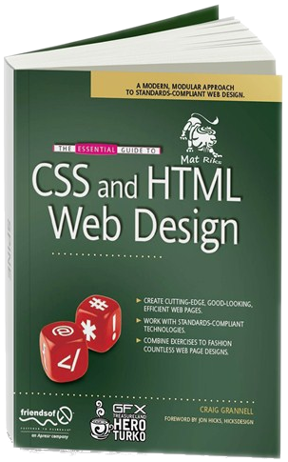

Web Design, HTML, CSS
Web Design, HTML, CSS, text, graphics, links, tables, forms, ...

Slide 76
Web Design, HTML, CSS
The questions of this syllabus section are covering the following areas:
The design, development and testing of websites
Basic HTML tags: Insert a formatted text, images, links (links), tables
Language for styling websites CSS
Aligning content in a webpage

Slide 77
Web Design, HTML, CSS (2)
Characteristics of the page (background color, images, alignment, page titles, page encoding, meta tags), paragraphs, fonts, colors, inserting images
Making web design (image) to a website. Control systems for content
Frames (frames). Navigation: transfer of management within (frames)

Slide 78
Question
k
K
K
K
k

Slide 79
Answer
k
K
k
Information:
k

Slide 80





JavaScript
Development of scripts with JavaScript, basic JavaScript constructs, operators, objects, manipulation of DOM tree

Slide 81
JavaScript
The questions of this syllabus section are covering the following areas:
Scripting languages ​​for Internet programming: JavaScript, Perl, VBScript. General information about JavaScript. Data types. Variables. Assignment operator. Operations and expressions. Conditional operator. Loop. Functions in JavaScript. Objects in JavaScript. Arrays. Classes Date, Math. Objects document, window, navigator. Events in JavaScript. Object model and DOM manipulation with JavaScript.

Slide 82
Question
k
K
K
K
k

Slide 83
Answer
k
k
Information:
k

Slide 84
Telerik Academy
?
?
?
?
?
Questions?
?
?
?
?
?
http://schoolacademy.telerik.com

